Slide 1
REQUIREMENT ENGINEERING
JIMMA UNIVERSITY
JIMMA INSTITUTE OF TECHNOLOGY
FACULTY OF COMPUTING AND INFORMATICS
CHAPTER SIX
REQUIREMENTS MANAGEMENT
Notes:
IT Project Management - ITec 2063

Slide 2
Topics we will cover
Stable and volatile requirements
Requirements identification
Requirements change factors
Change management
Traceability

Slide 3
Requirements Management
The process of managing change to the requirements for a system
The principal concerns of requirements management are:
  Managing changes to agreed requirements
  Managing the relationships between requirements
  Managing the dependencies between the requirements document and other documents produced in the systems engineering process
Requirements cannot be managed effectively without requirements traceability.
  A requirement is traceable if you can discover who suggested the requirement, why the requirement exists, what requirements are related to it and how that requirement relates to other information such as systems designs, implementations and user documentation

Slide 4
Requirements Management
“The purpose of requirements management is to ensure product development goals are successfully met.”
Requirements management provides a way to avoid errors by keeping track of changes in requirements and fostering communication with stakeholders from the start of a project throughout the engineering lifecycle.
Having a requirements management plan is critical to the success of a project because it enables engineering teams to control the scope and direct the product development lifecycle.
Good requirement management planning and process allows you to execute that plan, helping to reduce costs, accelerate time to market and improve quality control.

Slide 5
Requirements Change Factors
The changing need of system stakeholders
Changes in the environment in which the system is to be installed
Changes in the business which plans to install the system
Changes in laws and regulations

Slide 6
Requirement Management Planning and Process
A requirements management plan and process helps explain how you will receive, analyze, document and manage all of the requirements within a project.
A typical requirements management process complements the systems engineering through these steps:
    Collect requirement document
    Trace requirements to work items
    Query stakeholders after implementation on needed changes to requirements
    Utilize test management to verify and validate system requirements
    Assess impact of changes
    Revise requirements
    Document changes
The product manager is typically responsible for requirements management

Slide 7
Stable and Volatile Requirements
Requirements changes occur while the requirements are being elicited, analyzed and validated and after the system has gone into service.
Some requirements are usually more subject to change than others
  Stable requirements are concerned with the essence of a system and its application domain. They change more slowly than volatile requirements.
  Volatile requirements are specific to the instantiation of the system in a particular environment and for a particular customer.

Slide 8
Types of Volatile Requirements
Mutable requirements
  These are requirements which change because of changes to the environment in which the system is operating
Emergent requirements
  These are requirements which cannot be completely defined when the system is specified but which emerge as the system is designed and implemented
Consequential requirements
  These are requirements which are based on assumptions about how the system will be used. When the system is put into use, some of these assumptions will be wrong.
Compatibility requirements
  These are requirements which depend on other equipment or processes.

Slide 9
Requirements Identification
It is essential for requirements management that every requirement should have a unique identification
The most common approach is requirements numbering based on chapter/section in the requirements document
Problems with this are:
  Numbers cannot be unambiguously assigned until the document is complete
  Assigning chapter/section numbers is an implicit classification of the requirement. This can mislead readers of the document into thinking that the most important relationships are with requirements in the same section

Slide 10
Requirements Identification Techniques
Dynamic renumbering
  Some word processing systems allow for automatic renumbering of paragraphs and the inclusion of cross-references. As you re-organize your document and add new requirements, the system keeps track of the cross-reference and automatically renumbers your requirement depending on its chapter, section and position within the section
Database record identification
  When a requirement is identified it is entered in a requirements database and a database record identifier is assigned. This database identifier is used in all subsequent references to the requirement
Symbolic identification
  Requirements can be identified by giving them a symbolic name which is associated with the requirement itself. For example, EFF-1, EFF-2, EFF-3 may be used for requirements which relate to system efficiency

Slide 11
Storing Requirements
Requirements have to be stored in such a way that they can be accessed easily and related to other system requirements
Possible storage techniques are
  In one or more word processor files - requirements are stored in the requirements document
  In a specially designed requirements database

Slide 12
Change Management
Change management is concerned with the procedures, processes and standards which are used to manage changes to system requirements
Change management policies may cover:
  The change request process and the information required to process each change request
  The process used to analyze the impact and costs of change and the associated traceability information
  The membership of the body which formally considers change requests
  The software support (if any) for the change control process

Slide 13
The Change Management Process
Some requirements problem is identified.
  This could come from an analysis of the requirements, new customer needs, or operational problems with the system. The requirements are analyzed using problem information and requirements changes are proposed.
The proposed changes are analyzed
  This checks how many requirements (and, if necessary, system components) are affected by the change and roughly how much it would cost, in both time and money, to make the change.
The change is implemented.
  A set of amendments to the requirements document or a new document version is produced. This should, of course, be validated using whatever normal quality checking procedures are used.

Slide 14
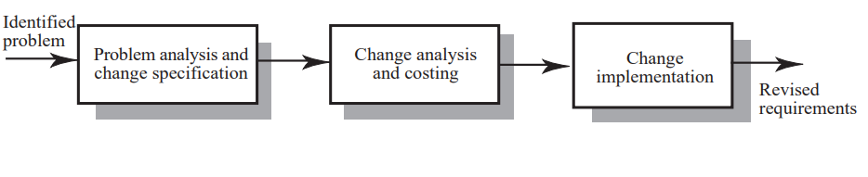
Change Management Stages

Slide 15
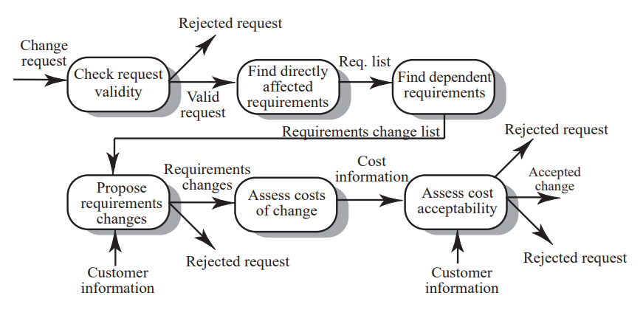
Change Analysis and Costing

Slide 16
Change Analysis Activities
The change request is checked for validity. Customers can misunderstand requirements and suggest unnecessary changes.
The requirements which are directly affected by the change are discovered.
Traceability information is used to find dependent requirements affected by the change.
The actual changes which must be made to the requirements are proposed.
The costs of making the changes are estimated.
Negotiations with customers are held to check if the costs of the proposed changes are acceptable.

Slide 17
Change Request Rejection
If the change request is invalid. This normally arises if a customer has misunderstood something about the requirements and proposed a change which isn’t necessary.
If the change request results in consequential changes which are unacceptable to the user.
If the cost of implementing the change is too high or takes too long.

Slide 18
Change Processing
Proposed changes are usually recorded on a change request form which is then passed to all of the people involved in the analysis of the change
Change request forms may include
    fields to document the change analysis
    data fields
    responsibility fields
    status field
    comments field

Slide 19
Traceability
Traceability information is information which helps you assess the impact of requirements change. It links related requirements and the requirements and other system representations
Types of traceability information
  Backward-from traceability: Links requirements to their sources in other documents or people
  Forward-from traceability: Links requirements to the design and implementation components
  Backward-to traceability: Links design and implementation components backs to requirements
  Forward-to traceability: Links other documents (which may have preceded the requirements document) to relevant requirements.

Slide 20
Types of Traceability
Requirements-sources traceability
  Links the requirement and the people or documents which specified the requirement
Requirements-rationale traceability
  Links the requirement with a description of why that requirement has been specified.
Requirements-requirements traceability
  Links requirements with other requirements which are, in some way, dependent on them. This should be a two-way link (dependents and is dependent on)

Slide 21
Types of Traceability
Requirements-architecture traceability
  Links requirements with the sub-systems where these requirements are implemented. This is particularly important where sub-systems are being developed by different sub-contractors
Requirements-design traceability
  Links requirements with specific hardware or software components in the system which are used to implement the requirement
Requirements-interface traceability
  Links requirements with the interfaces of external systems which are used in the provision of the requirements

Slide 22
Key Points
Stable and volatile requirements
Requirements identification
Requirements change factors
Change management
Traceability

Slide 23

Any Question?

